Slide 1
Agenda
JDK Installation
Hello World Program

Slide 2
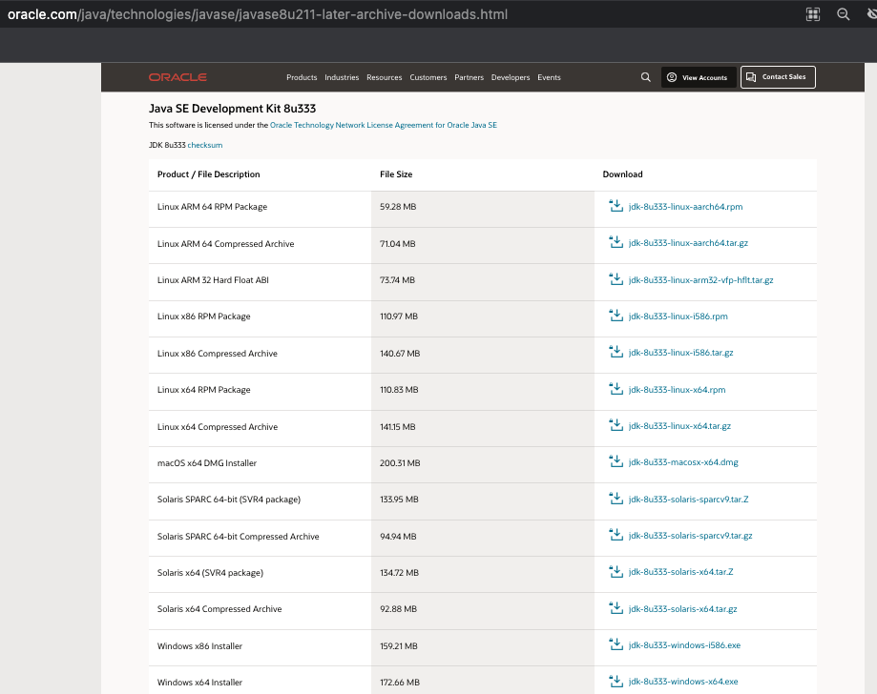
JDK Installation
Install JDK 1.8 version
https://www.oracle.com/java/technologies/downloads/#java8
Click on JDK Download link based on your operating system
Follow installation steps and install JDK.

Slide 3
First Program
Demo HelloWorld.java

Slide 4
Java Code Execution
Java source code
Java Compiler
(javac)
Java byte code
(platform
Independent)
.java
.class
Expected Result
Execute JRE
(java)

Slide 5
Lab
Get JDK
Practice HelloWorld.java

